Slide 1
Advancing job opportunities, health, and general prosperity
of the people of Jefferson County
Jefferson County Board of Legislators
April 30, 2024

Slide 2
Financial Assistance To support business growth
41 Active PILOTS:
● Averaging just over $1 M/yr. in payments
● $5 million in revenue in last 5 years.
Loans:
● 16 RLF & Micro-loans
● 21 COVID loans from our own funds

Slide 3
Technical Assistance with grants
Allied Motion Technologies
Clayton Distillery
Current Applications
EZ Stak
Great Lakes Cheese
MetalCraft Marine
New York Air Brake
North American Tapes
Roth Industries
The ARC (Productions Unlimited)
Treehouse Daycare

Slide 4
Child care
Supported by County ARPA funds
Free training for home-based day care
Mini grants for start-up costs
Retention payments to center-based programs (150)
Funding for new positions (5)
88 new home-based slots, 21 slots in process
Management and reporting software

Slide 5
Current major initiatives
YMCA Project
Corporate Park Turn Lane
Business Complex at Watertown International
Convalt Energy
Deferiet Mill Site Cleanup

Slide 6
Economic Development Marketing
Strategies, Tools, and Insights

Slide 7
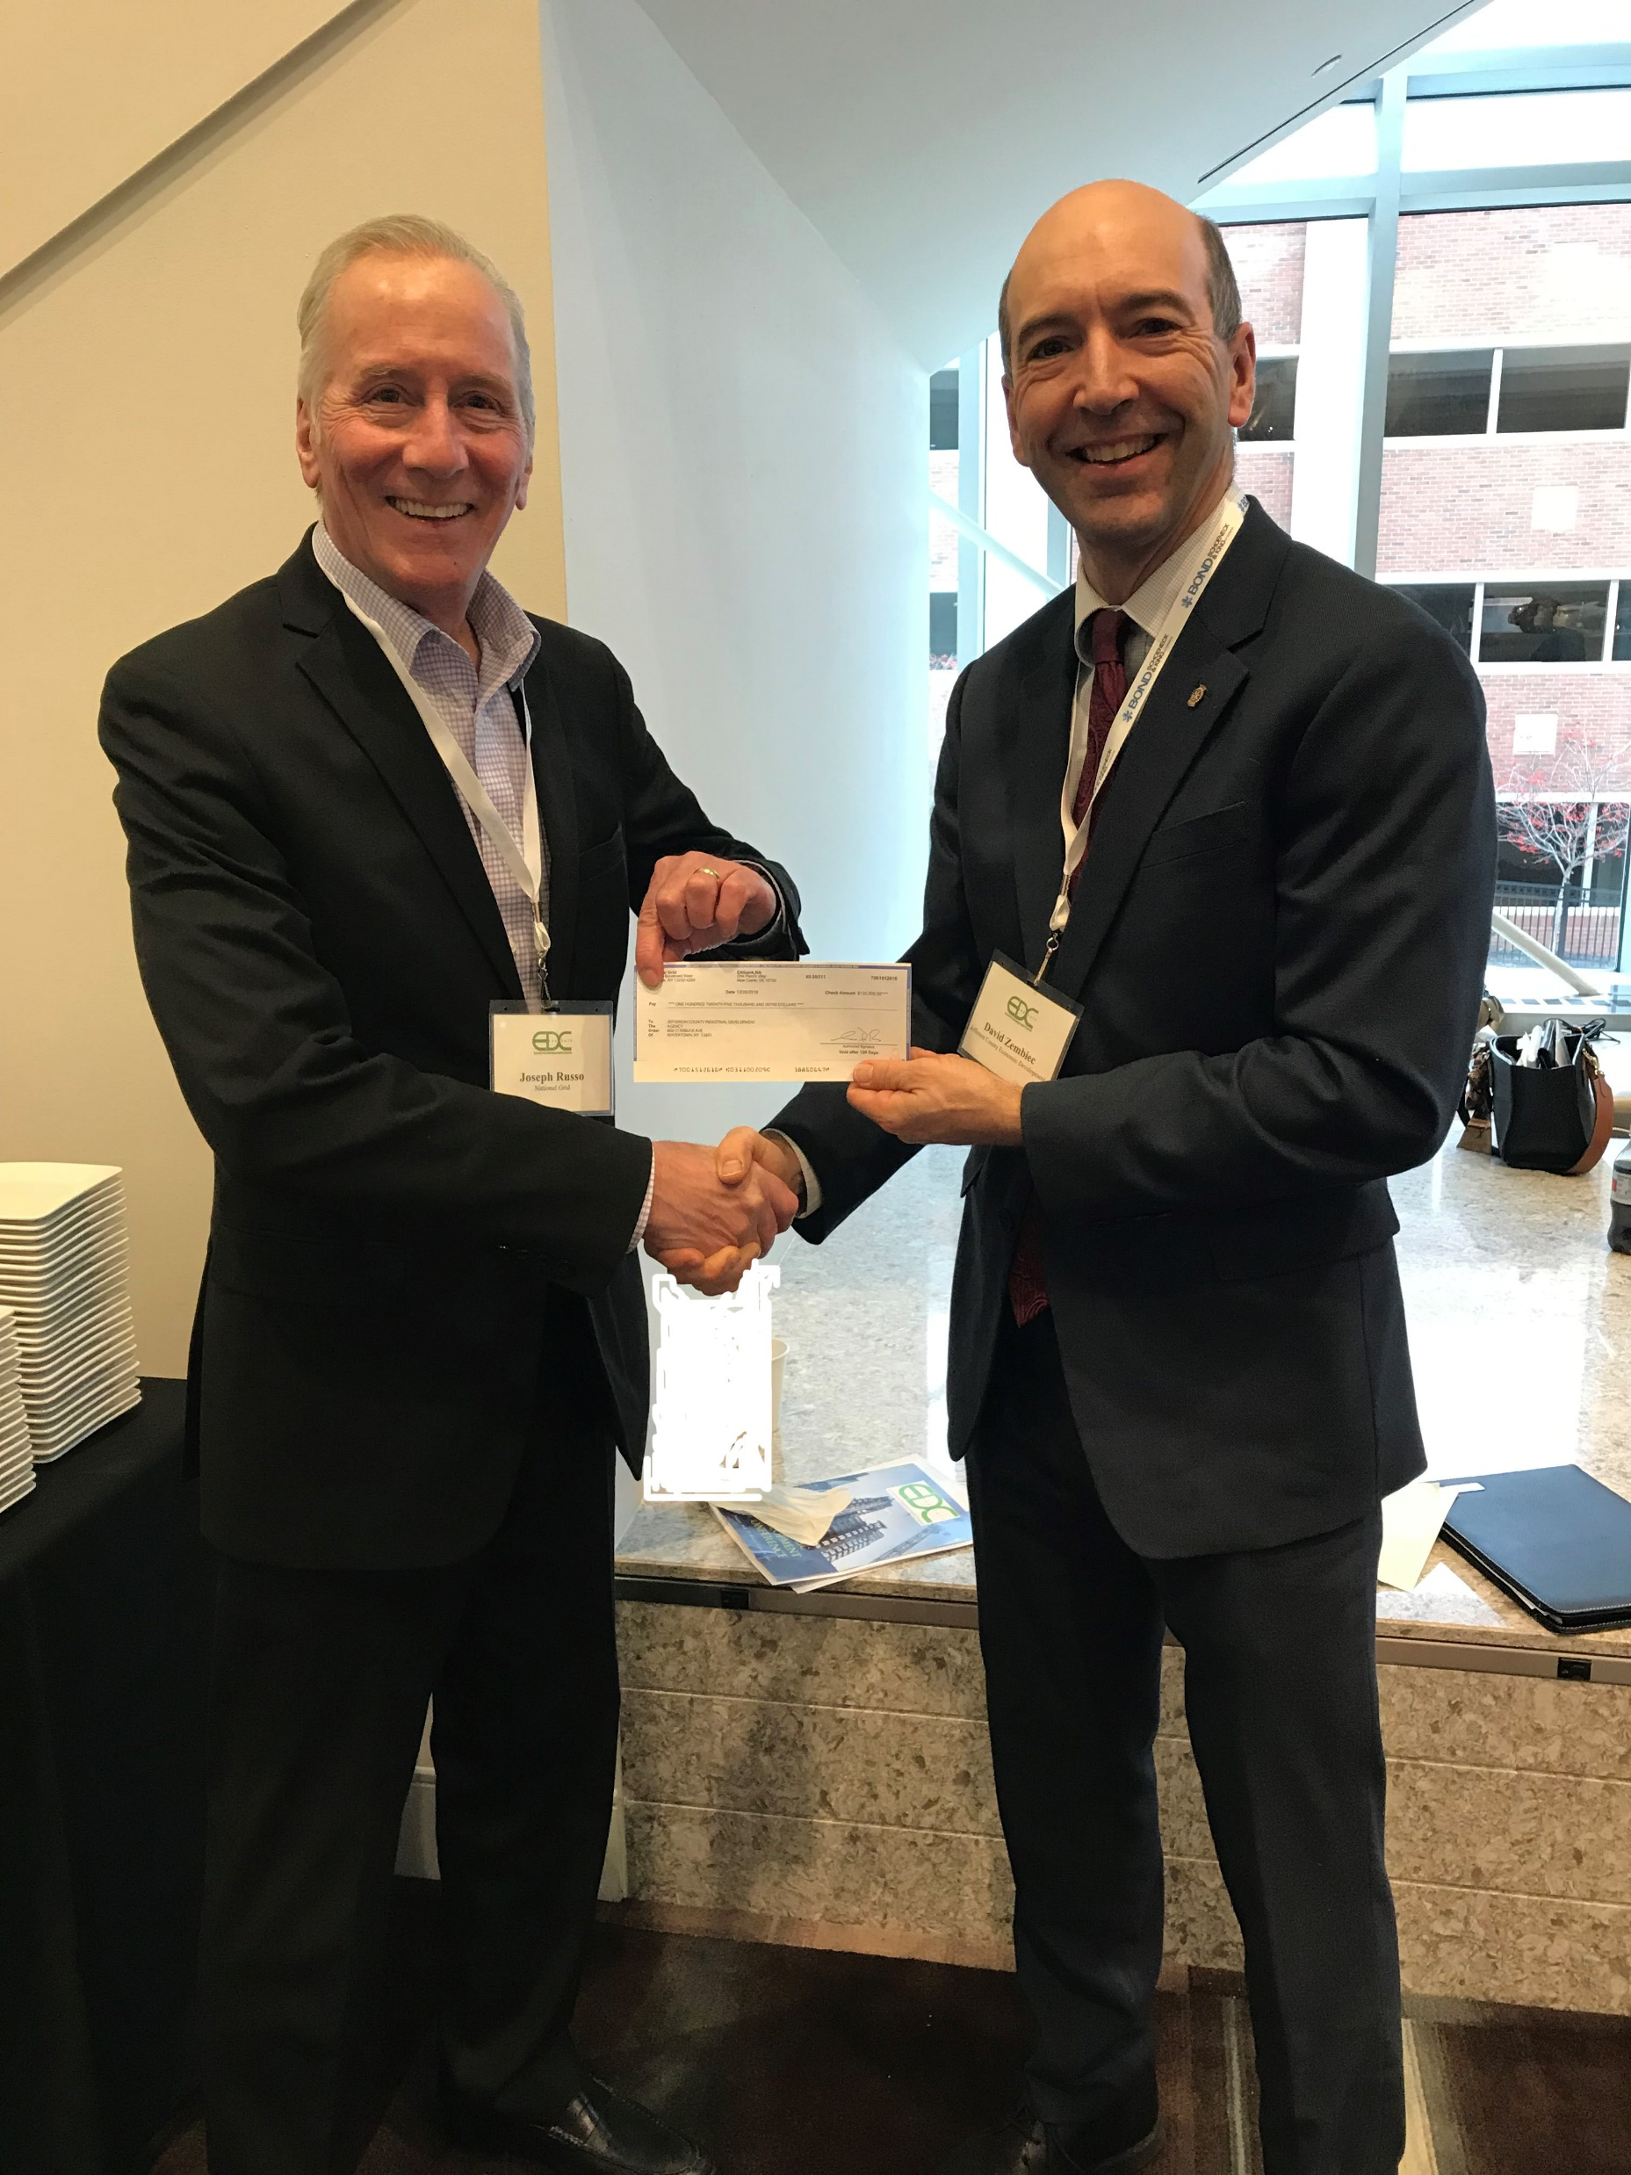
Economic Development Marketing involves promoting Jefferson County’s assets and opportunities to attract investment, businesses, talent, and visitors
Crucial for fostering growth, creating jobs, and enhancing the quality of life

Slide 8
Target Audience
Investors: Highlight financial incentives, infrastructure, and market potential.
Businesses: Emphasize workforce quality, business-friendly environment, and industry clusters.
Talent: Showcase career opportunities, lifestyle amenities, and educational institutions.
Tourists: Promote attractions, events, and unique experiences.

Slide 9
Branding Jefferson County, NY
Develop a distinctive brand that reflects your region's identity and values.
Consistent messaging across marketing materials, websites, and social media.
Engage stakeholders to build brand advocacy and community pride.

Slide 11
Marketing Strategies
Digital Marketing: Website optimization, content marketing, SEO, social media.
Re-Targeting Advertising: Utilize data-driven approaches to reach specific audiences.
Earned Media: Generate positive media coverage and manage reputation.
Economic Development Incentives: tax breaks, grants, and other incentives to attract
Newsletter

Slide 12
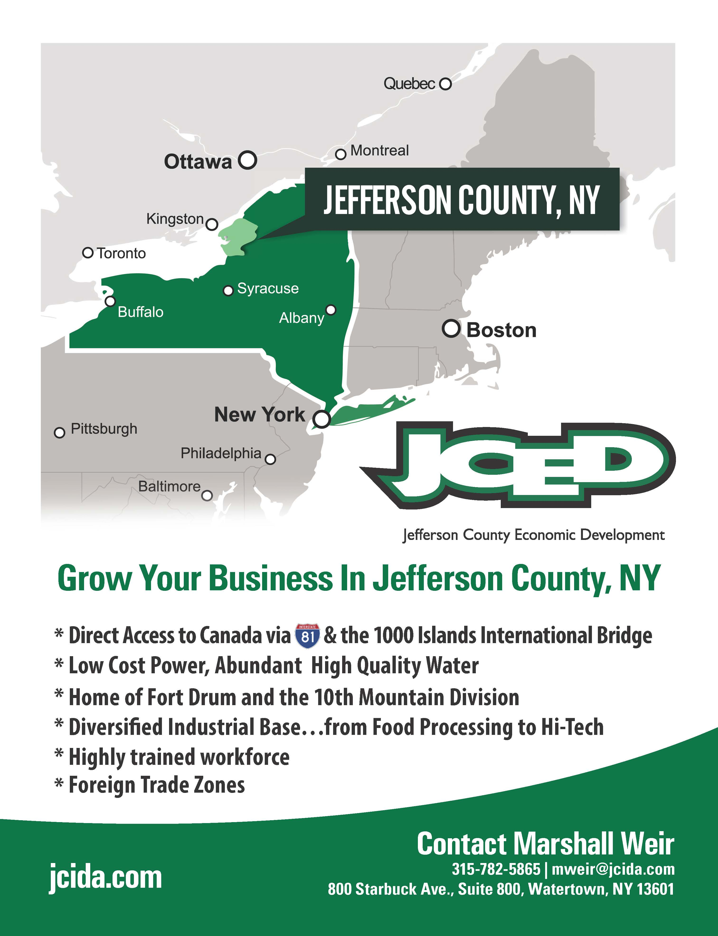

Slide 13
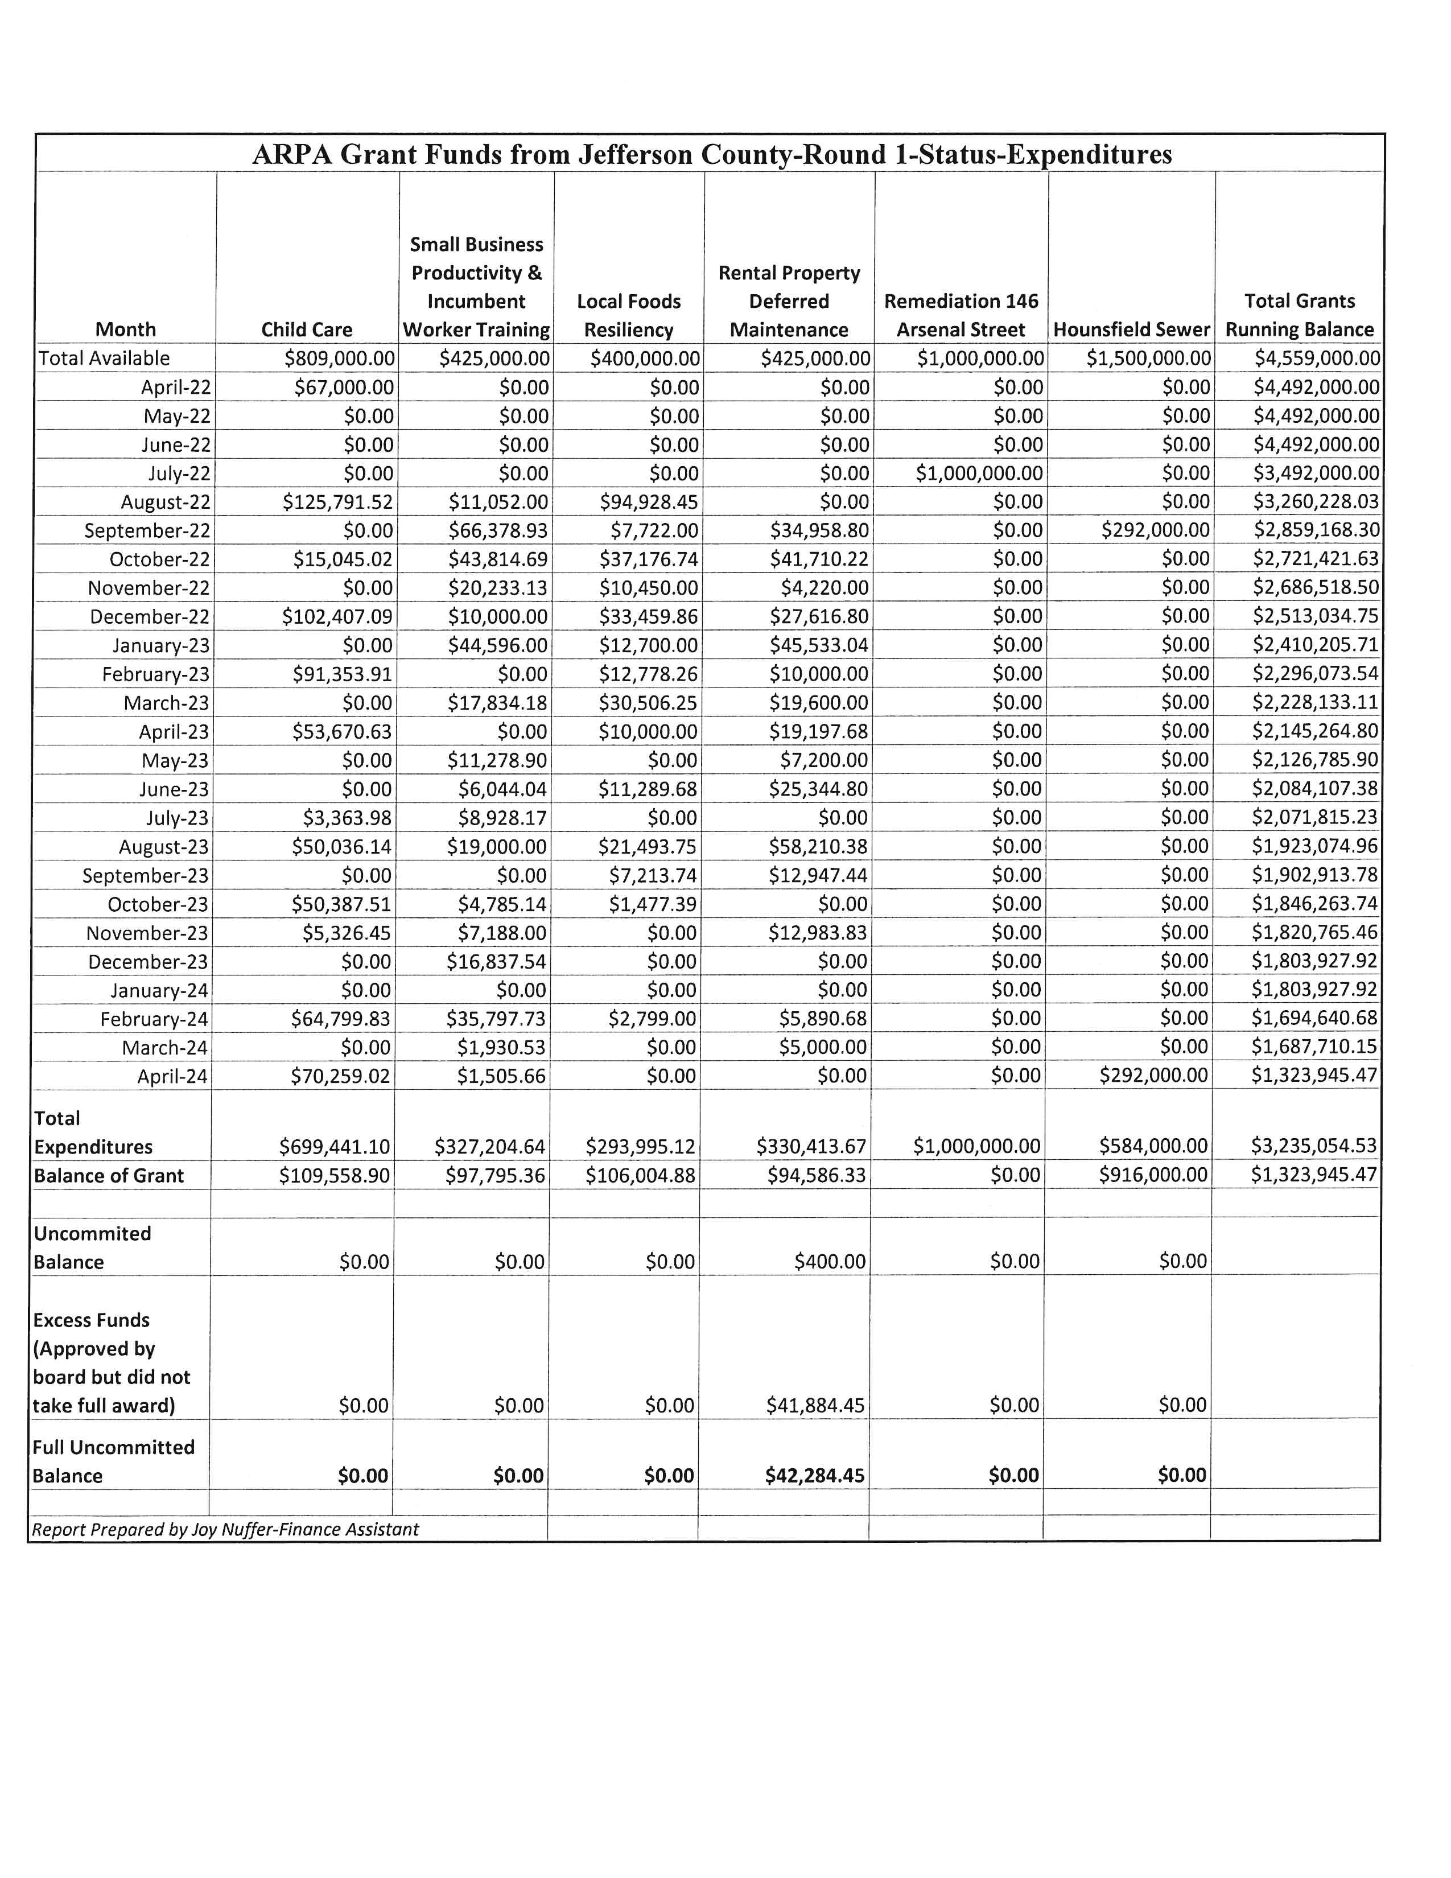
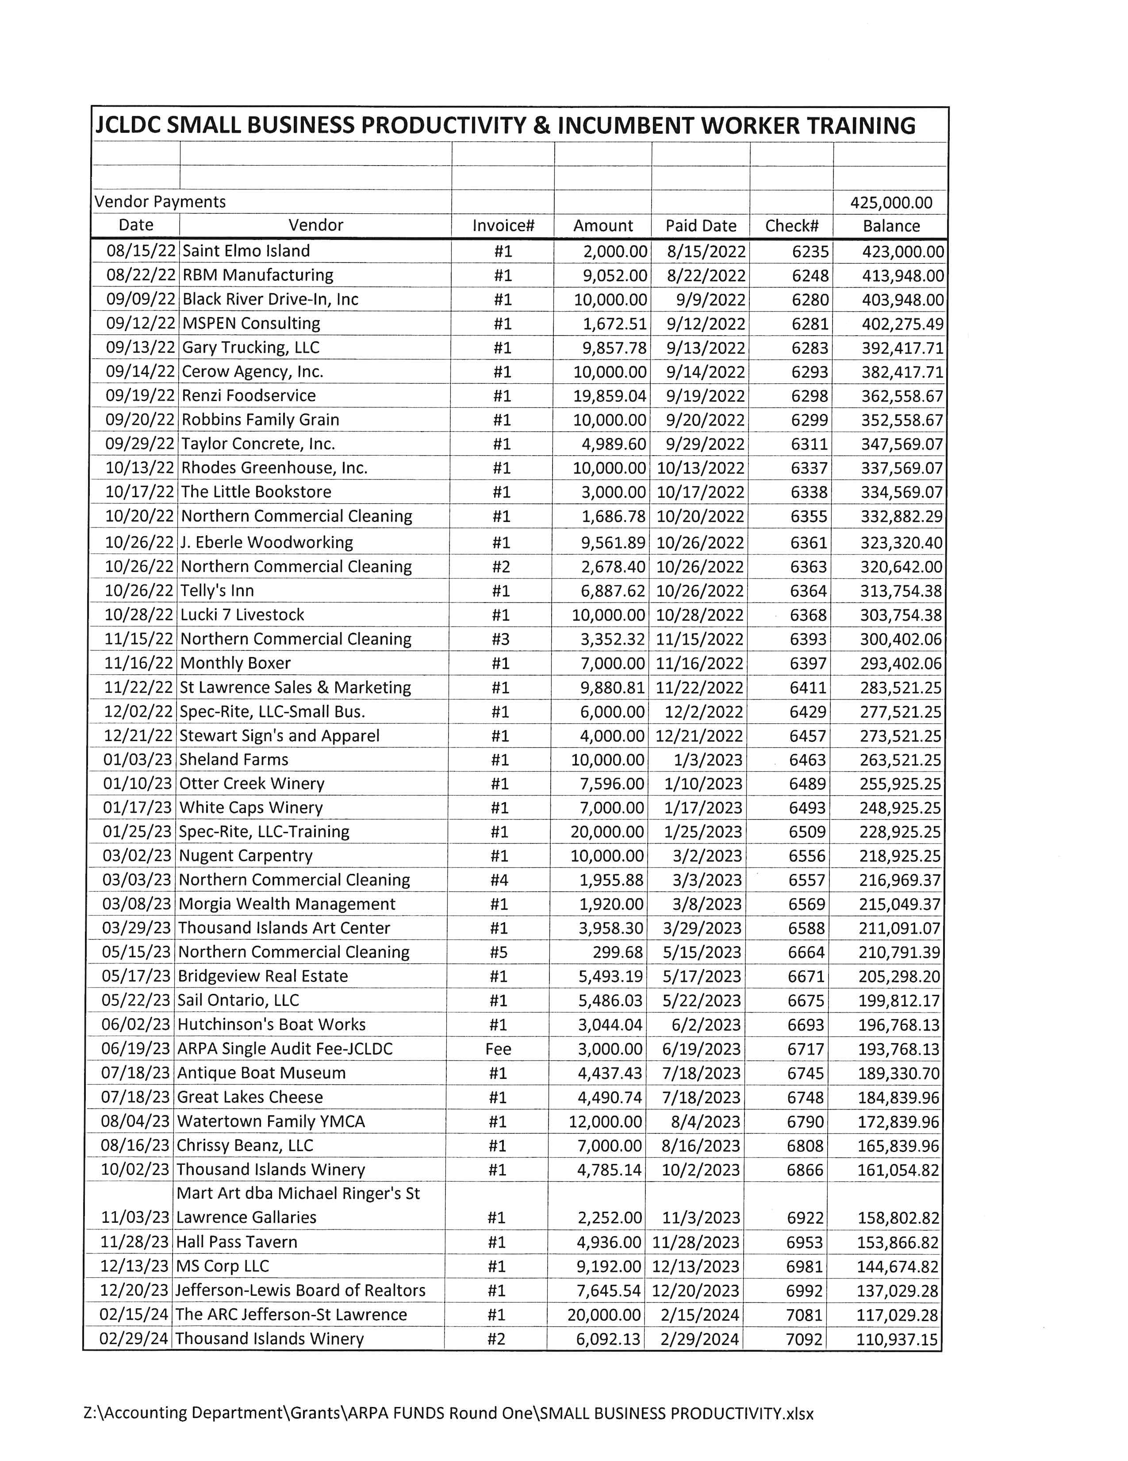
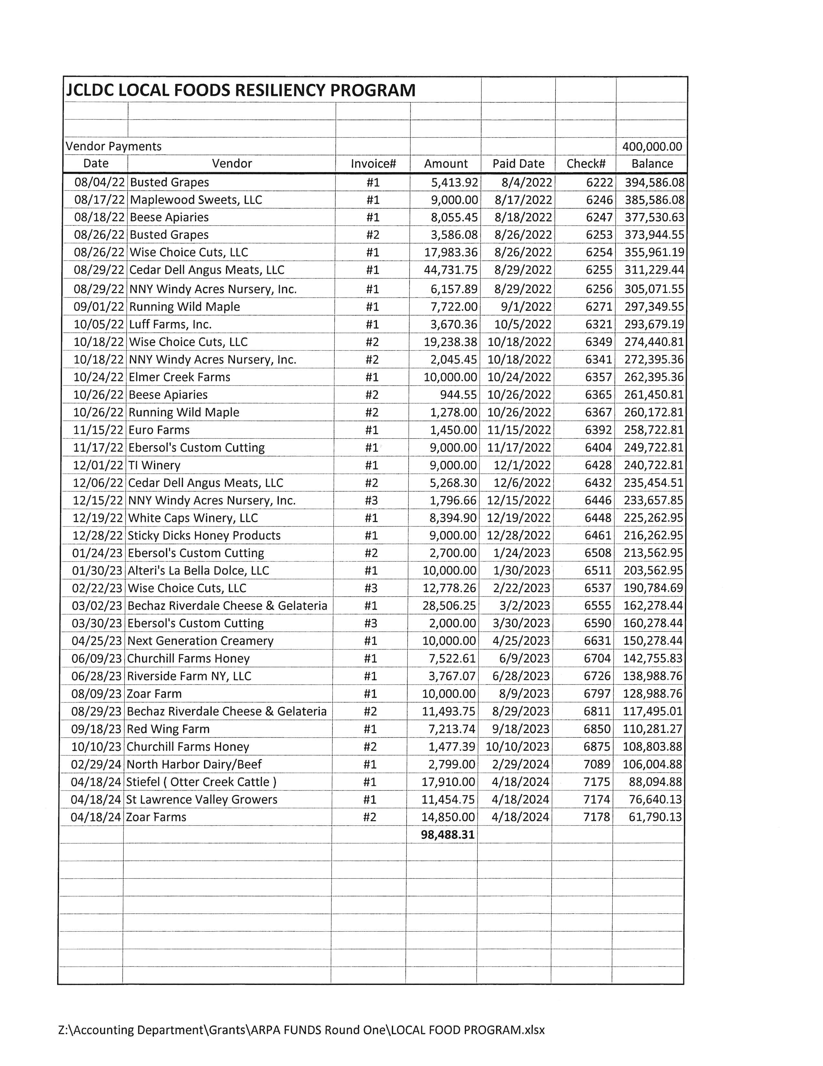
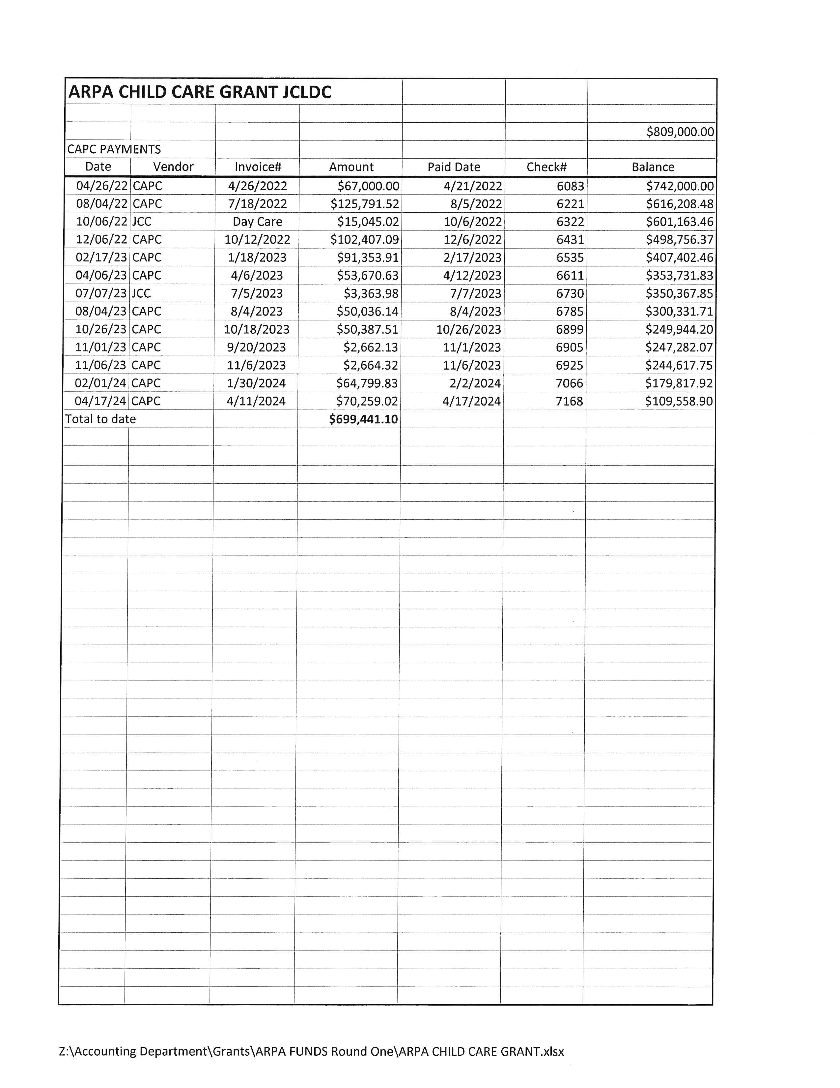
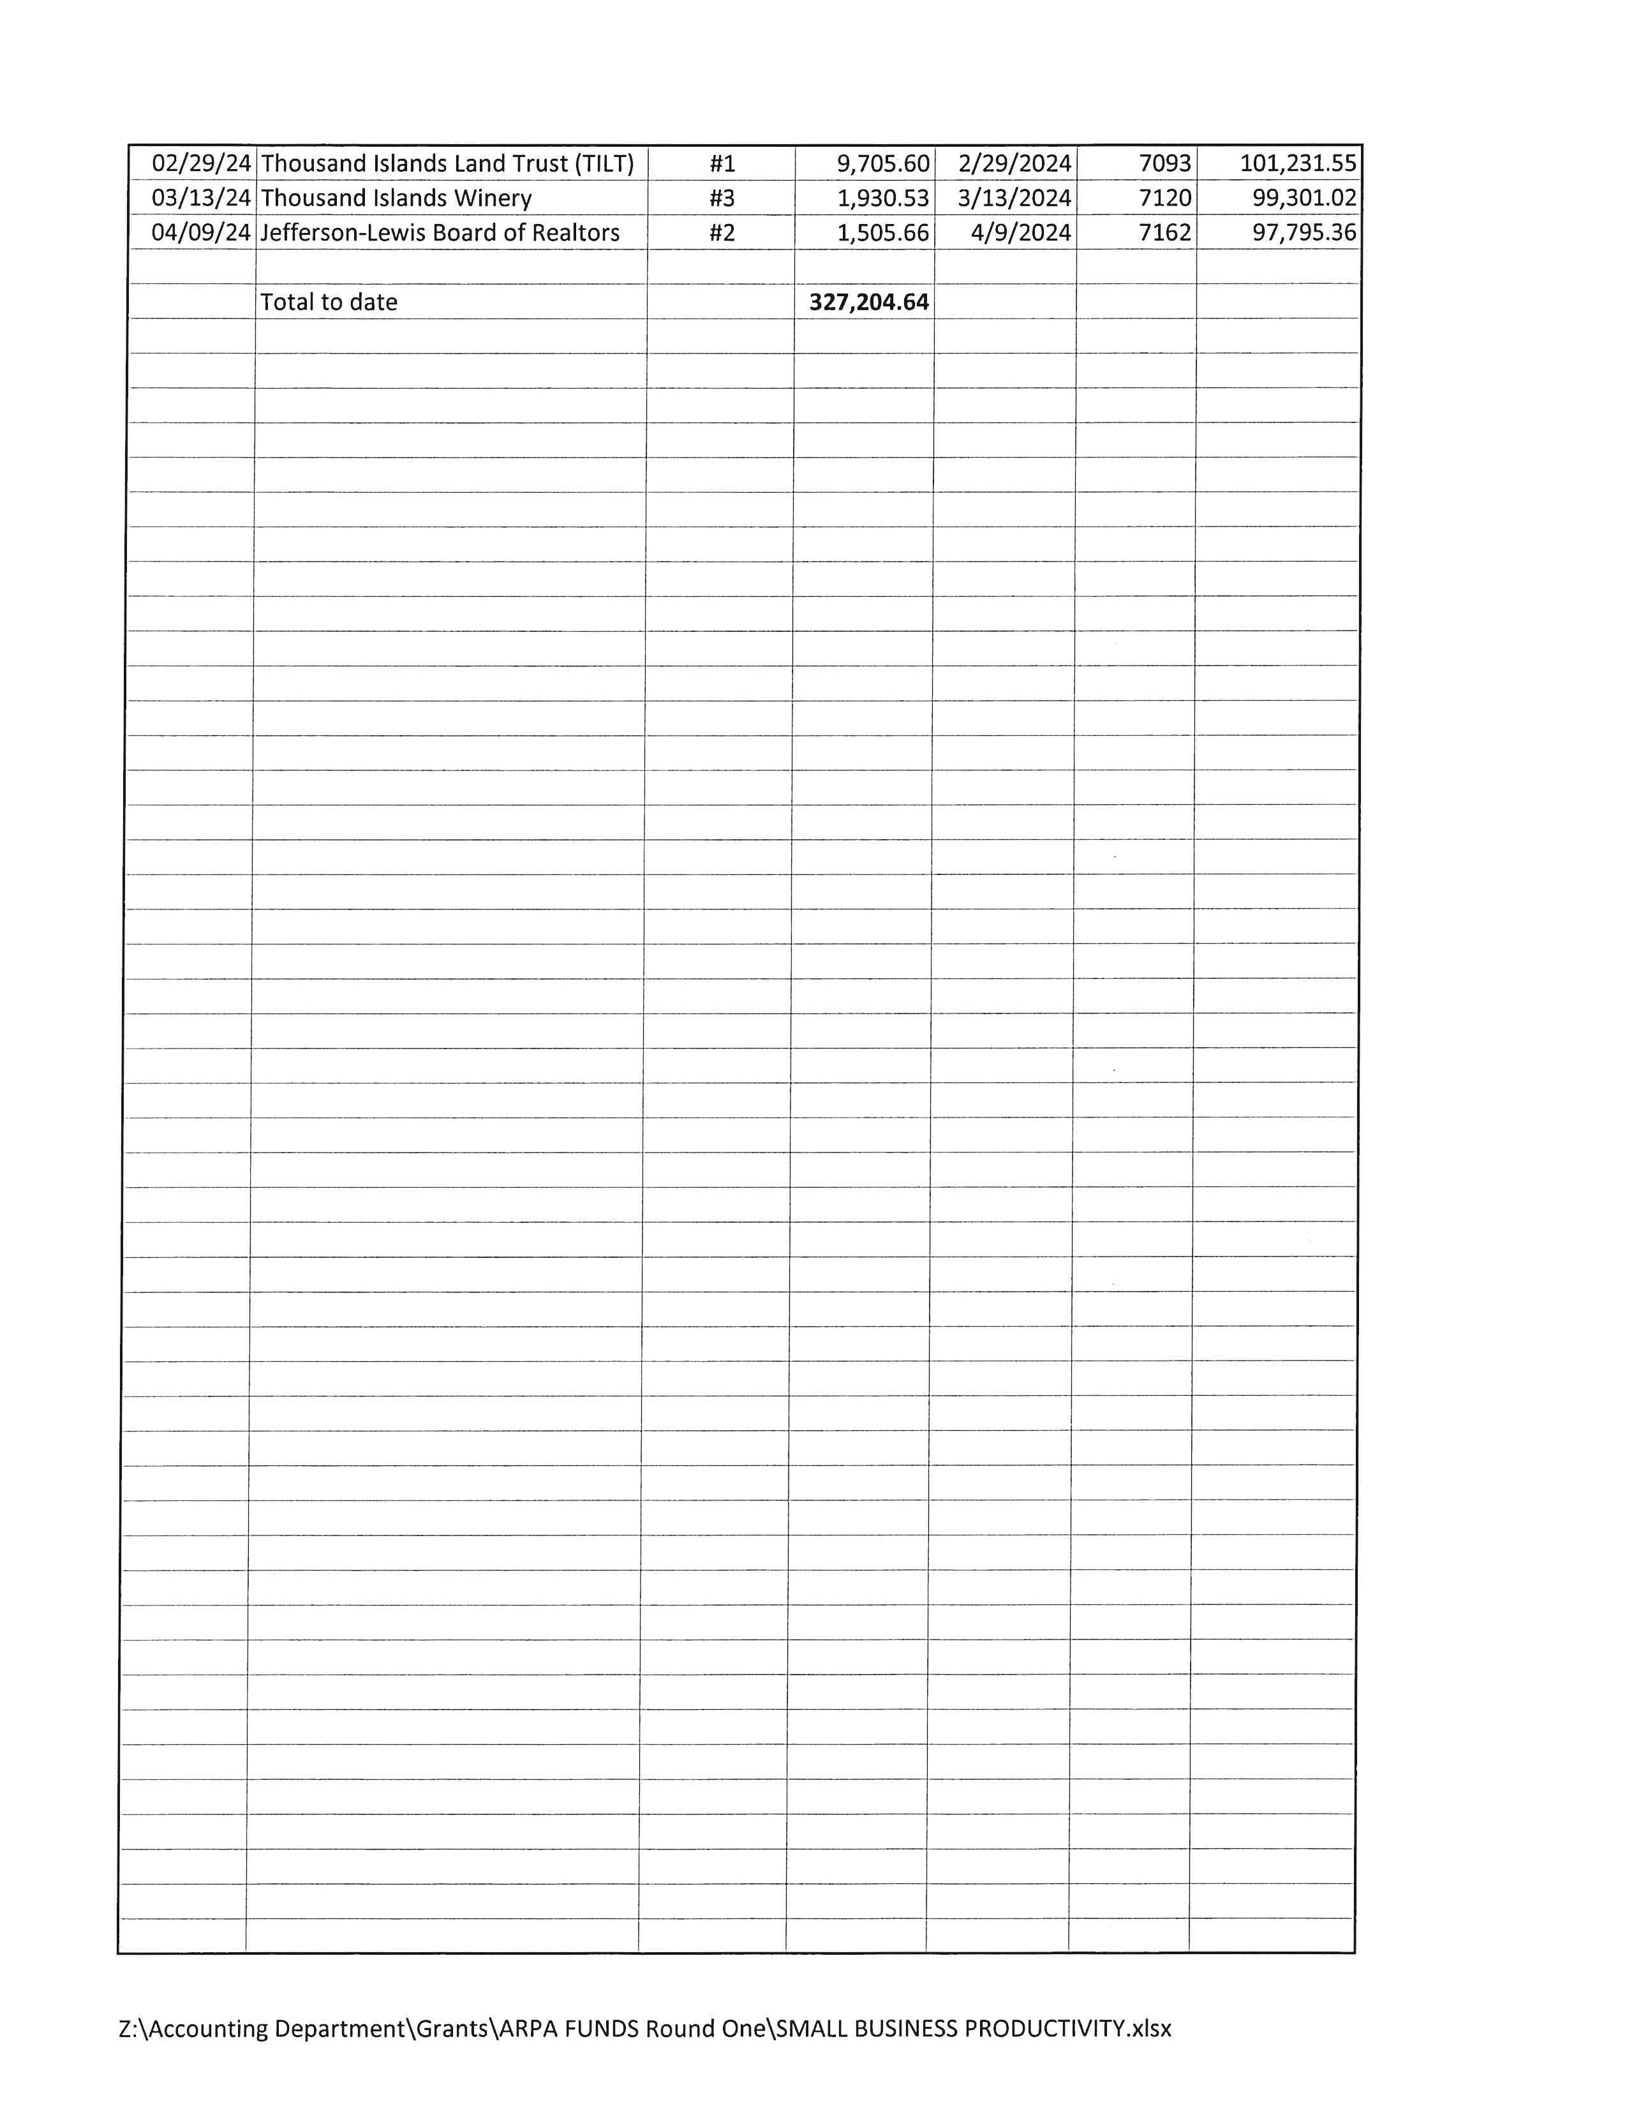

Slide 14
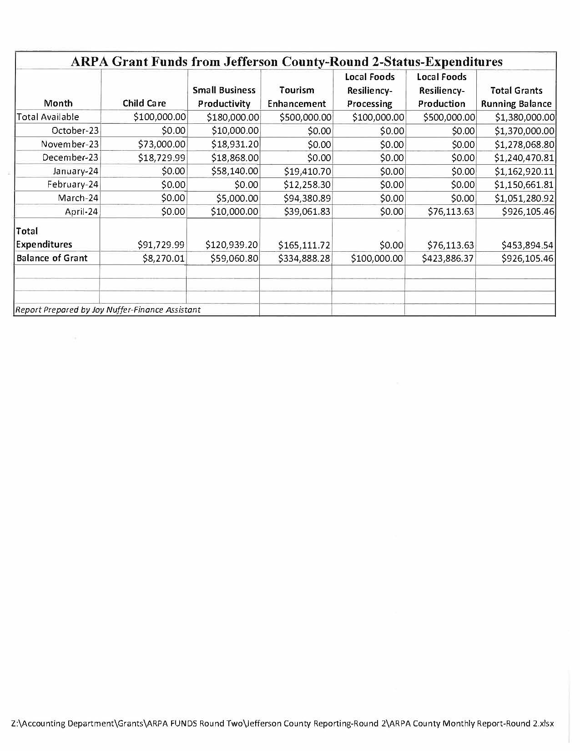
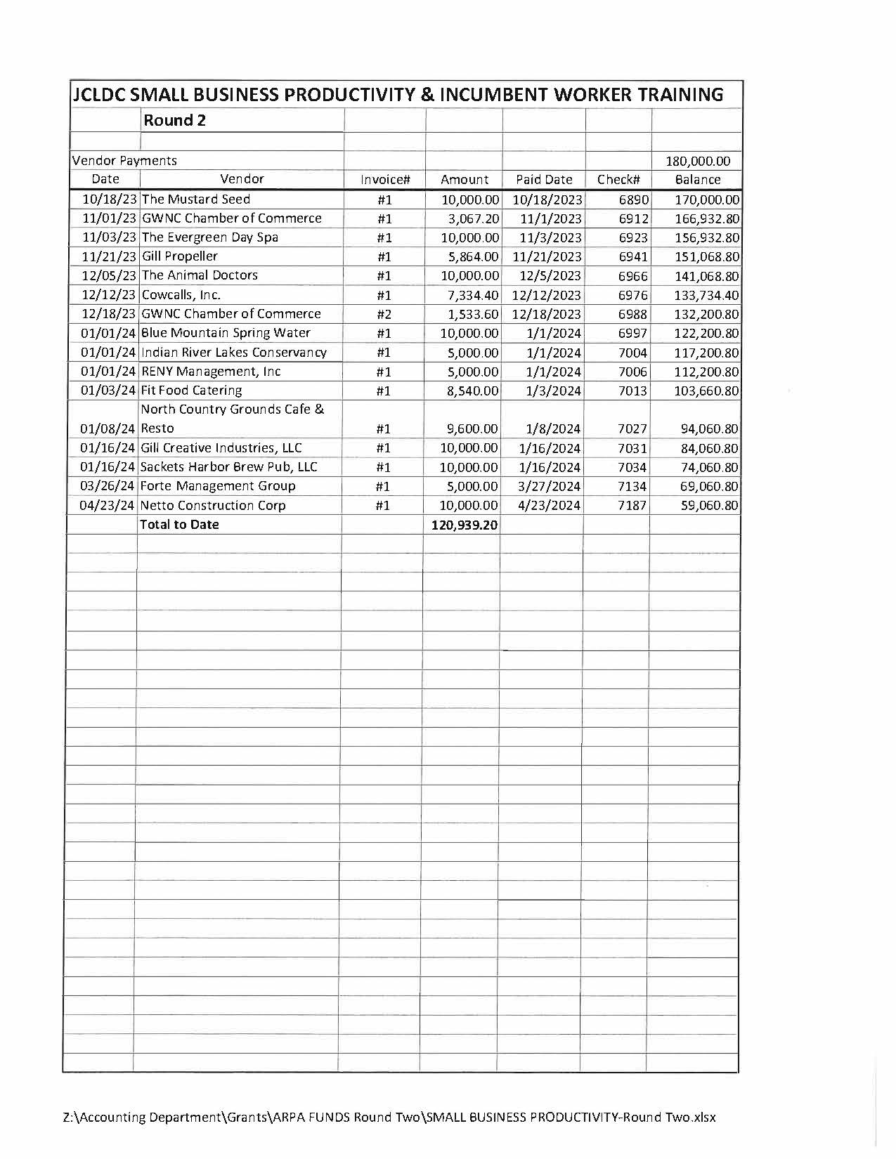
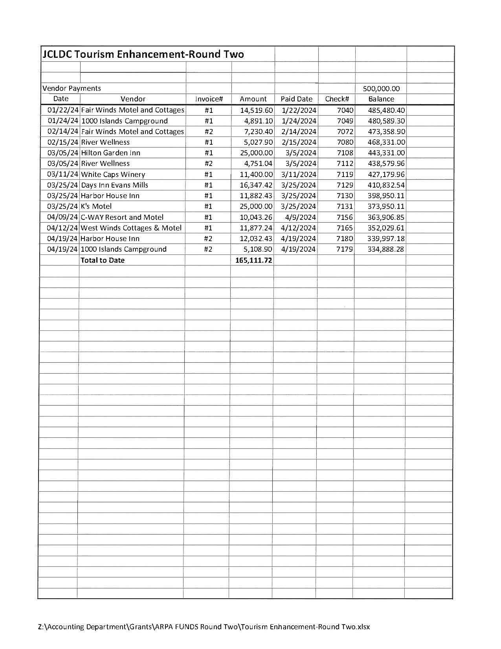
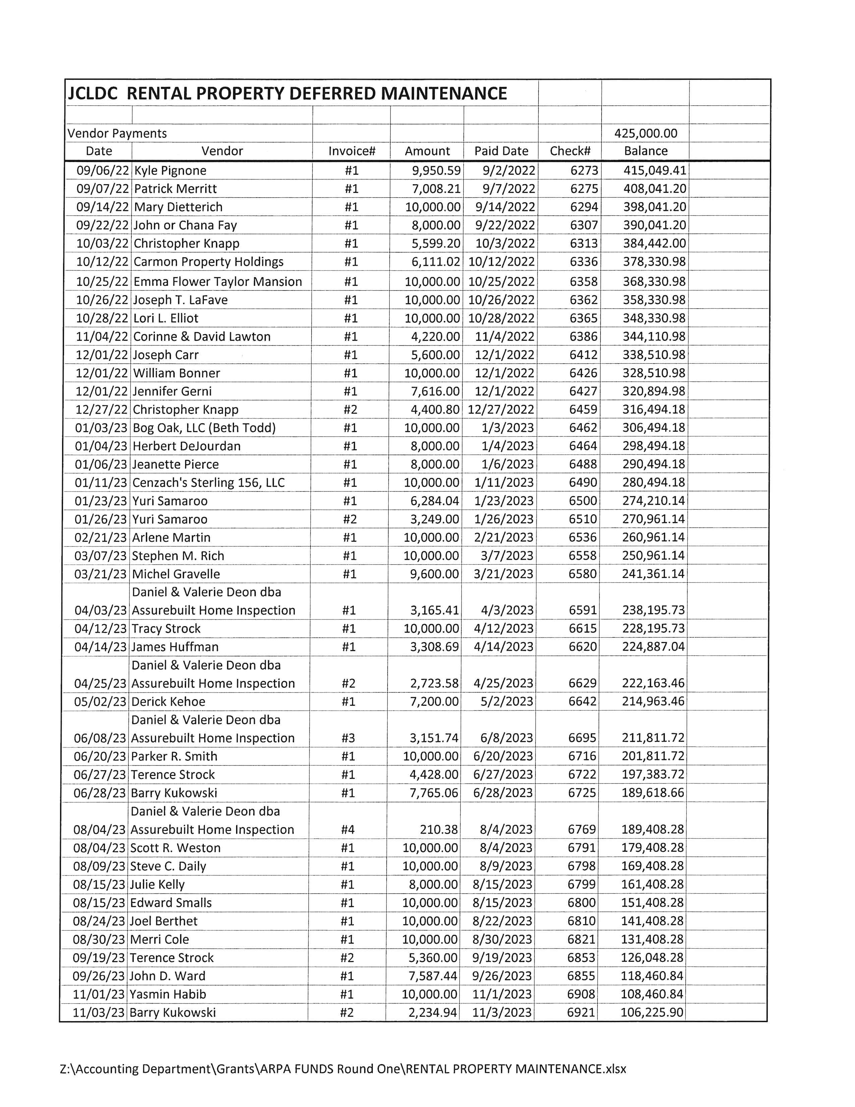
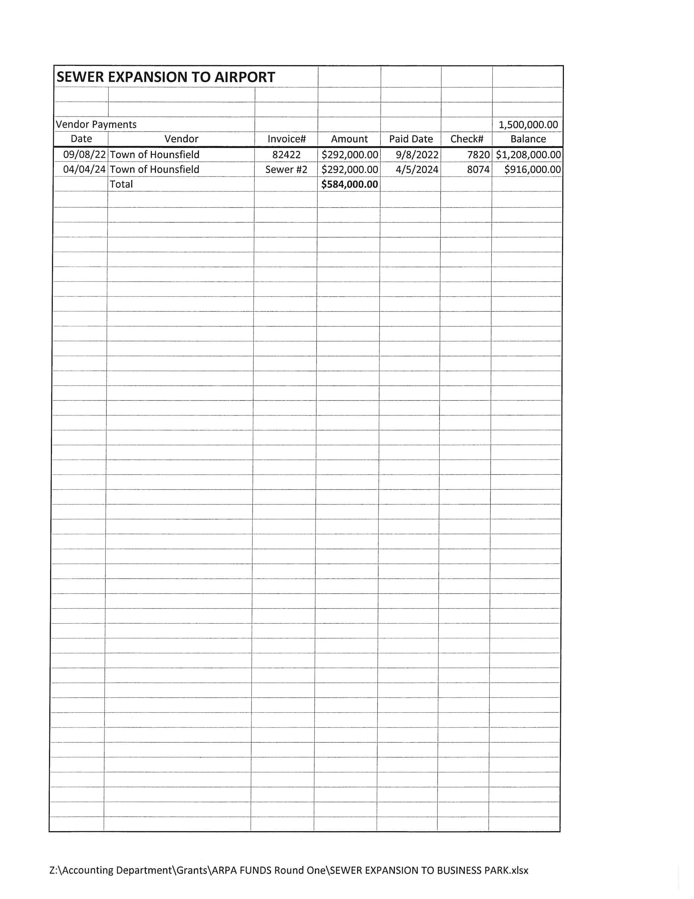
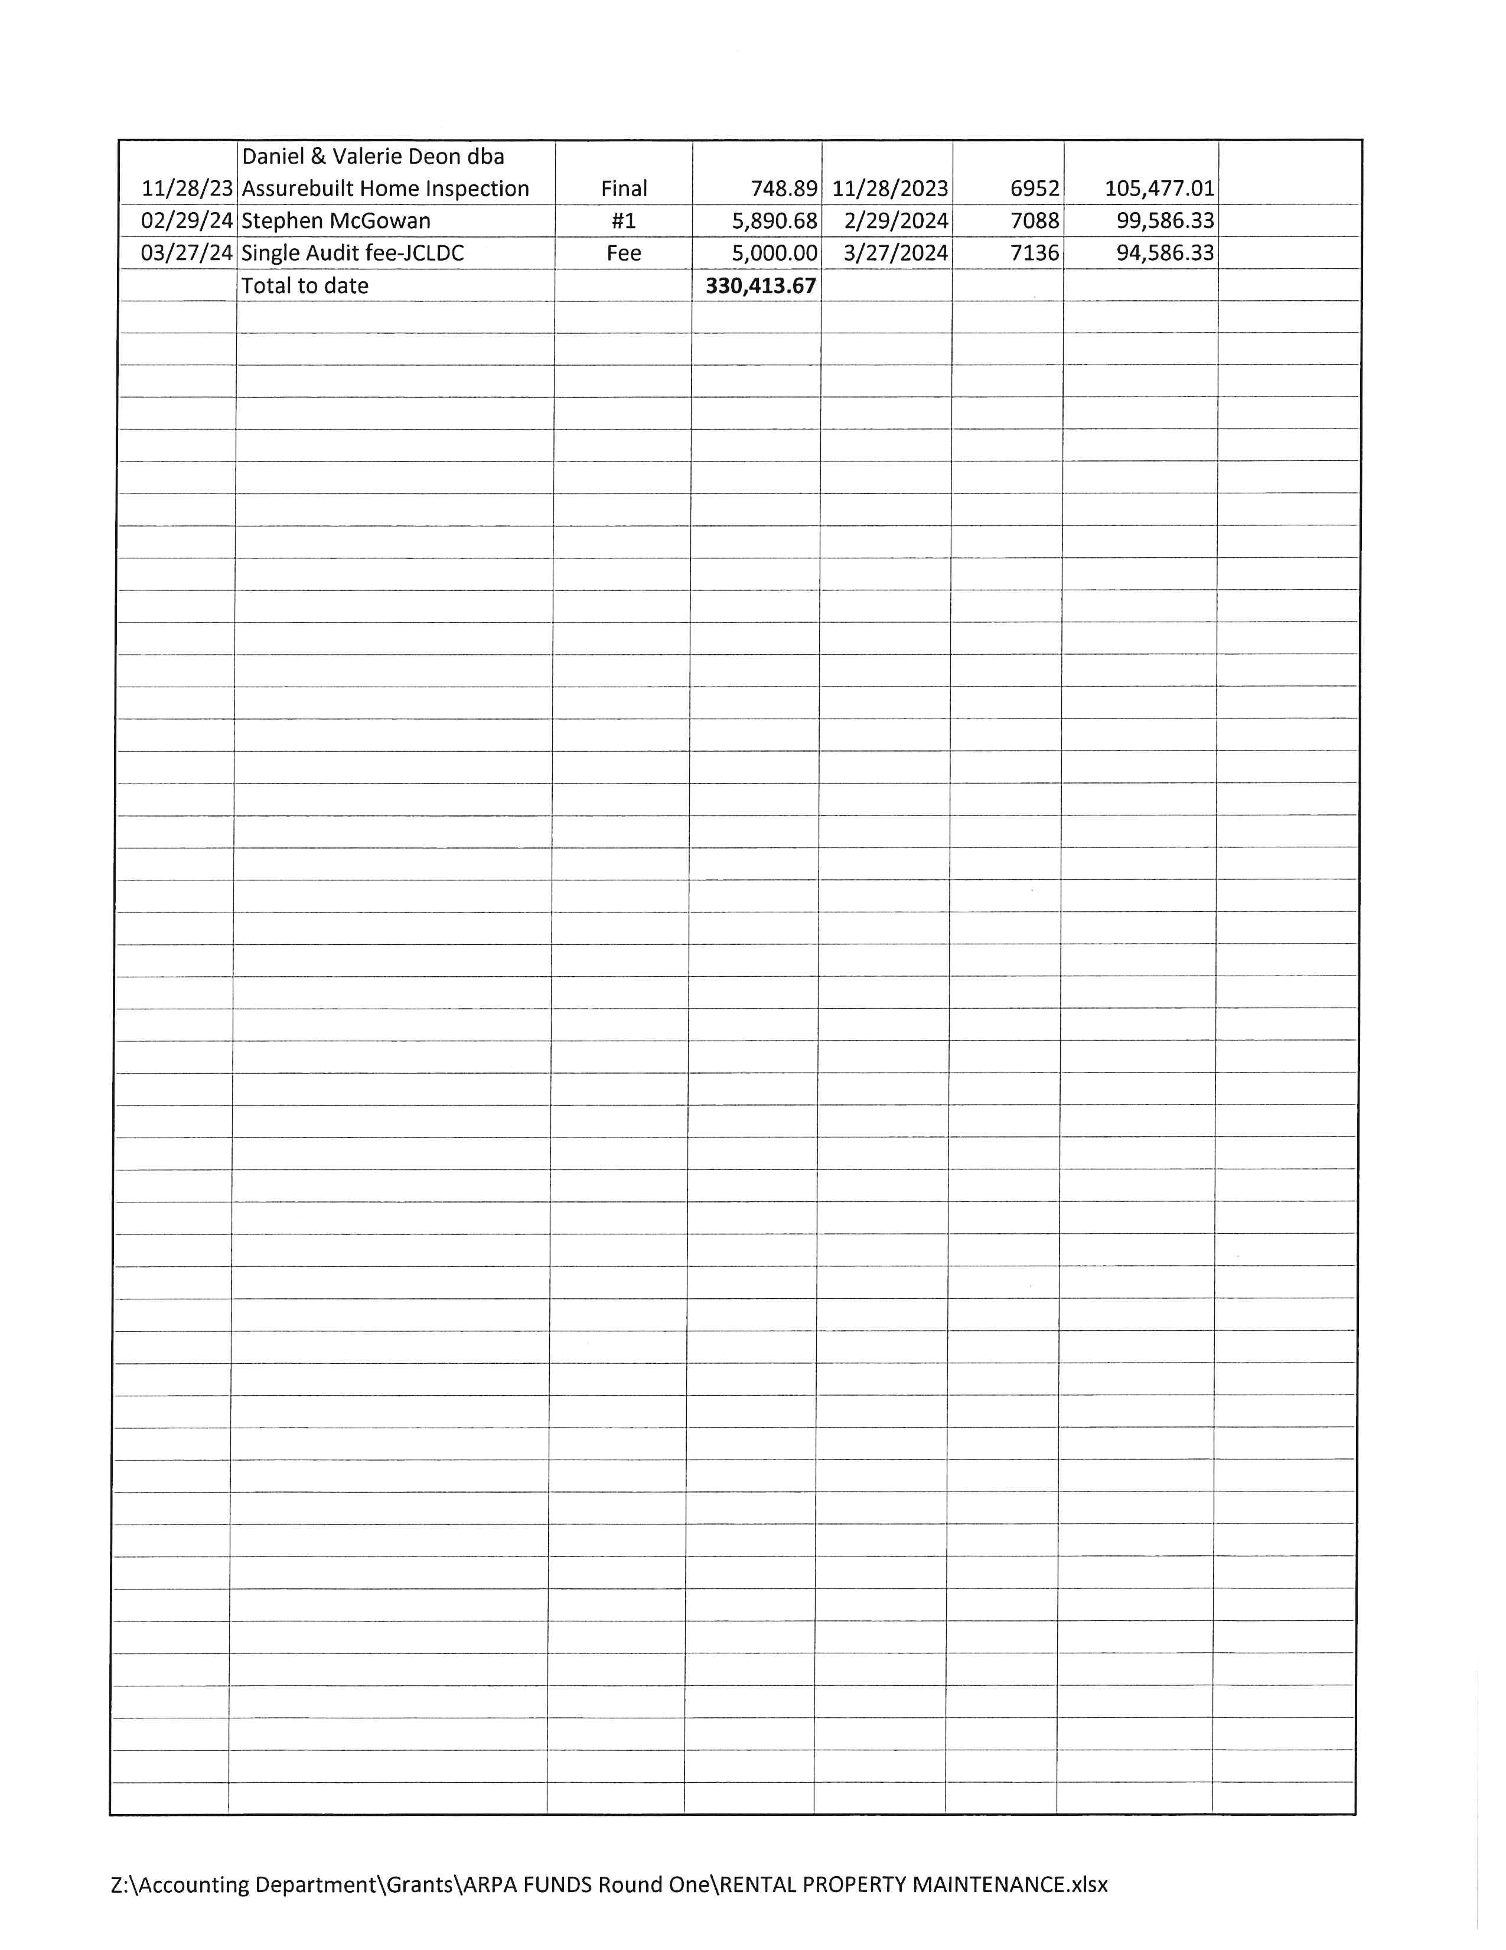

Slide 15
Businesses Assisted by Jefferson County’s ARPA Grant program: Small Business Productivity 66 Projects $ 480,644 Incumbent Worker Training 5 Projects $ 47,924 Tourism Enhancement: 14 Projects $ 429,998 Rental Property: 63 Projects $ 424,134

Slide 16
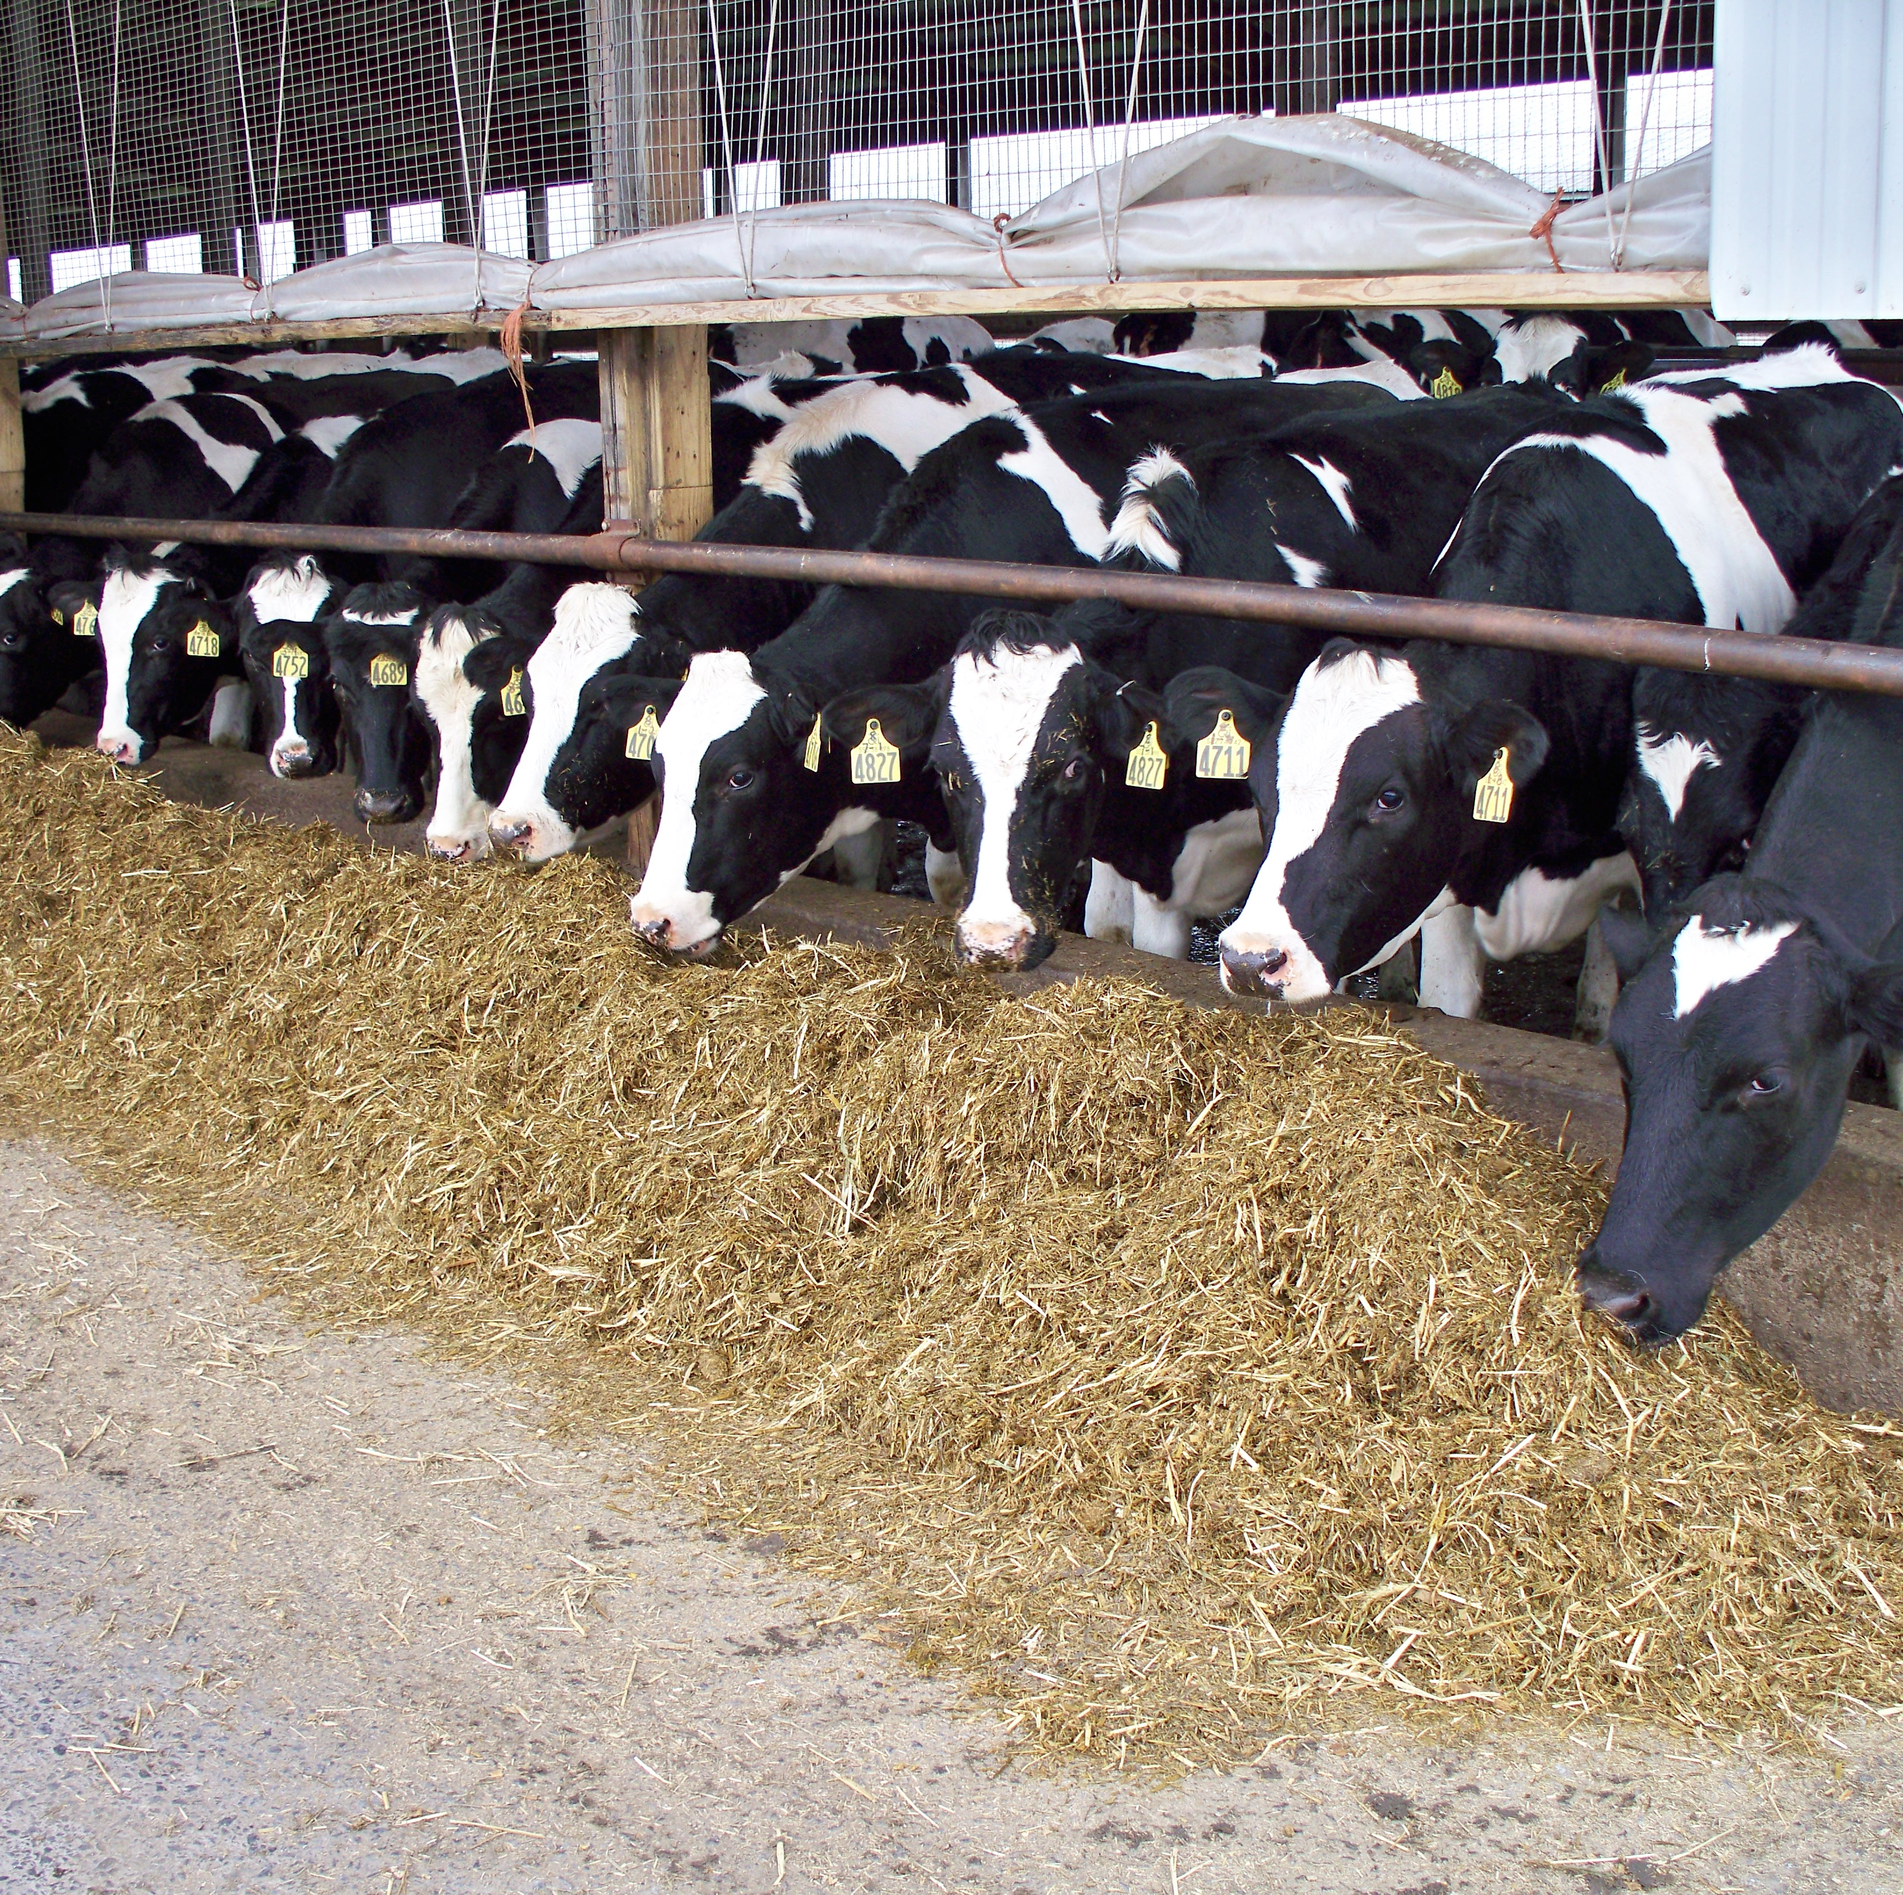
JCED Agricultural Economic Development Program
Since 2001, assisting in the retention, growth and promotion of Jefferson County’s Agricultural Industry.

Slide 17
Ag Manufacturing
Great Lakes Cheese in Adams (Cheese and powder)
HP Hood in LaFargeville (sour cream, cottage cheese, yogurt)
Gold Medal in Adams Center (animal feed)
Afgritech in Watertown (animal feed)

Slide 18
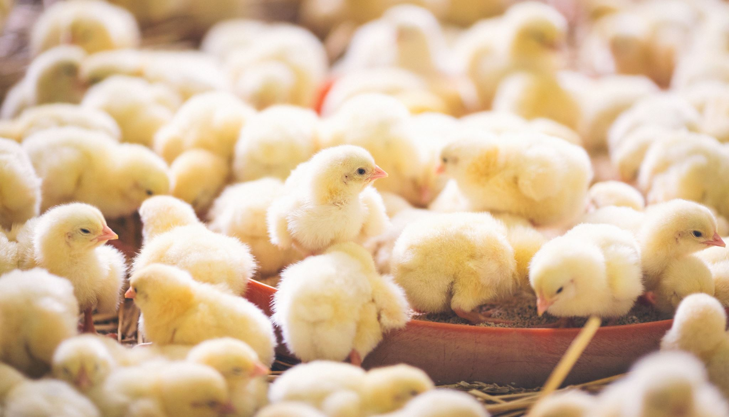
NNY’s new Ag Sector
Aviagen – 100,000 chicks per week, parent stock for other egg laying operations
CWT Farms Inc. – 1,000,000 chicks per week, broiler chicks to ship across northeast and into Canada

Slide 19
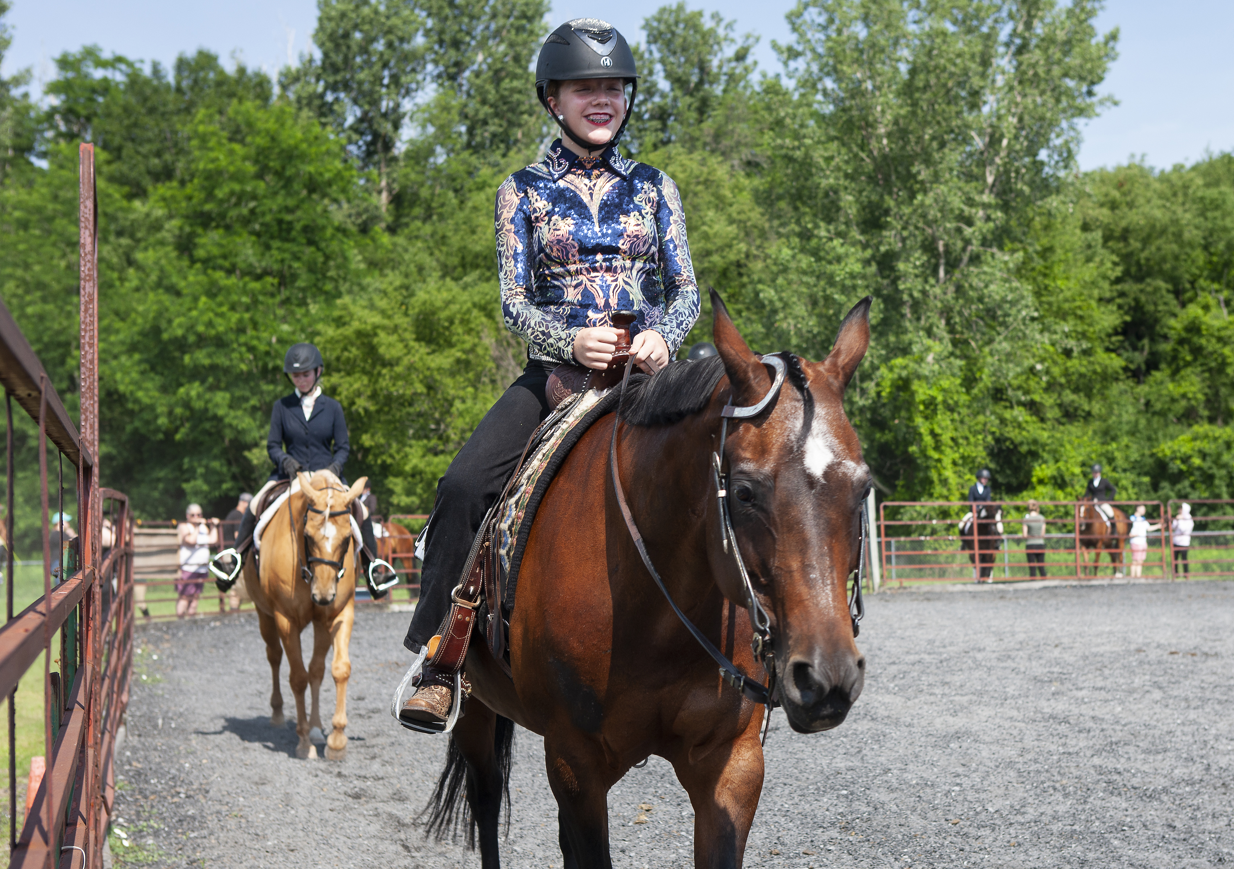
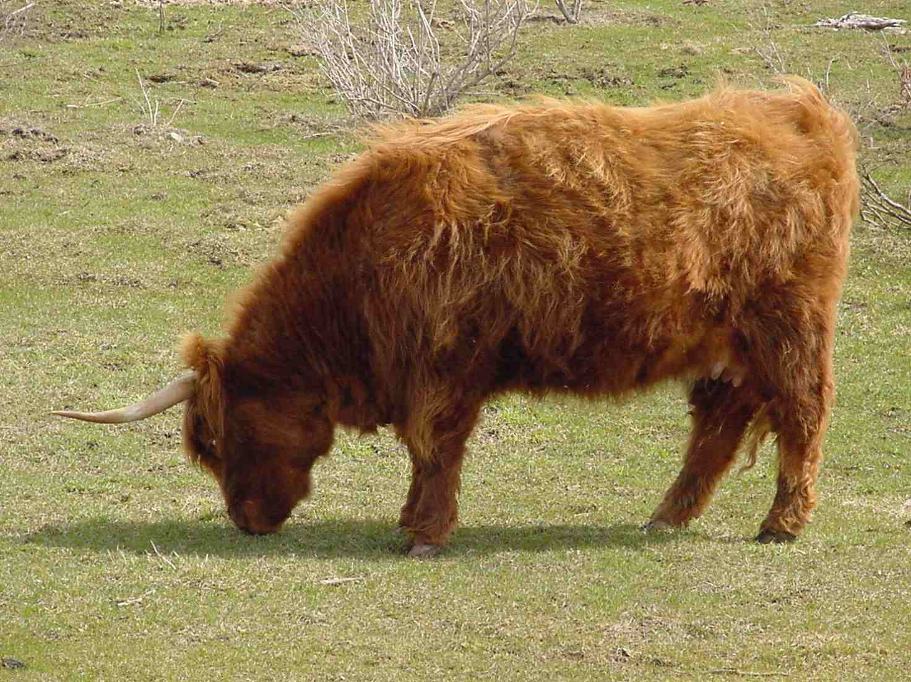
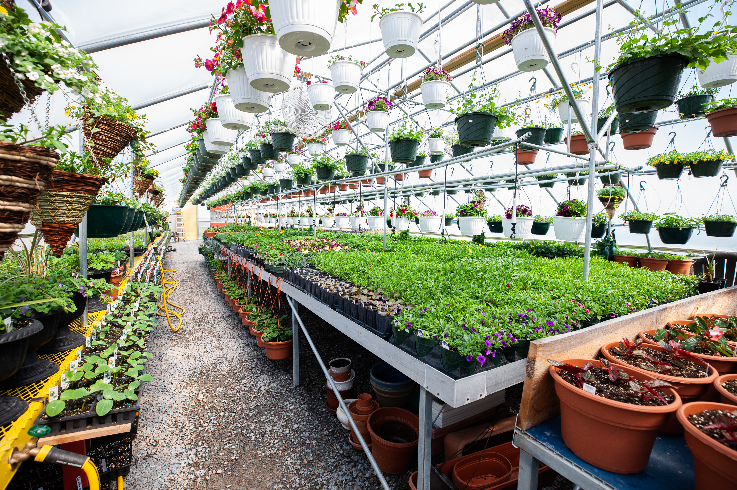
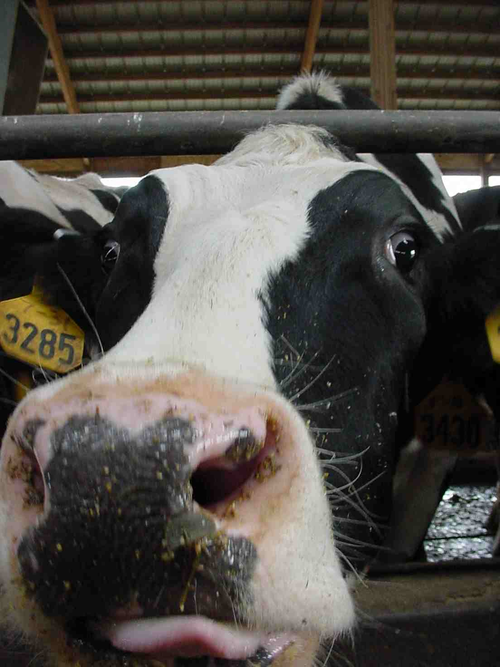
Farms

Slide 20
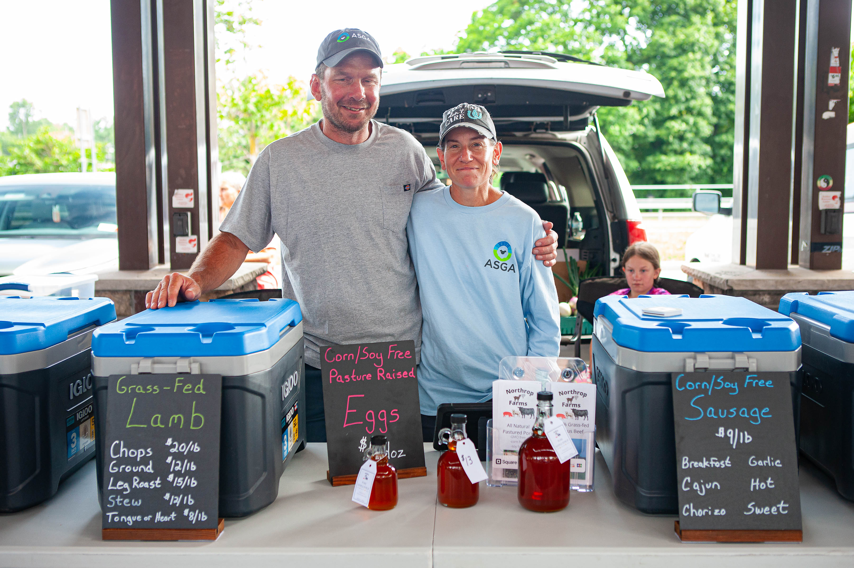
Agriculture’s Economic Impact
2019 Analysis – Dr. Todd Schmit, Professor at Cornell Dyson School of Applied Economics and Management’
Direct Impact of Agriculture in Jefferson, Lewis, Oswego and St. Lawrence Counties
$1.4 billion per year

Slide 21
Jefferson County Food Resiliency Program
Round 1 – JCBOL allocated $400,000 from ARPA funds to grow food processing capacity – THANK YOU!
Purpose is to increase local food supply, stimulate diversification of agriculture, grow economy.
24 projects including 3 custom meat processing, 3 farm based dairy processing, 1 poultry processing, 7 vegetable processing, honey, wine, maple syrup and other projects. 22 projects are finished, 2 remain open.
Monitor Projects for 5 years.
Funds left over are rolled into Round 2.

Slide 22
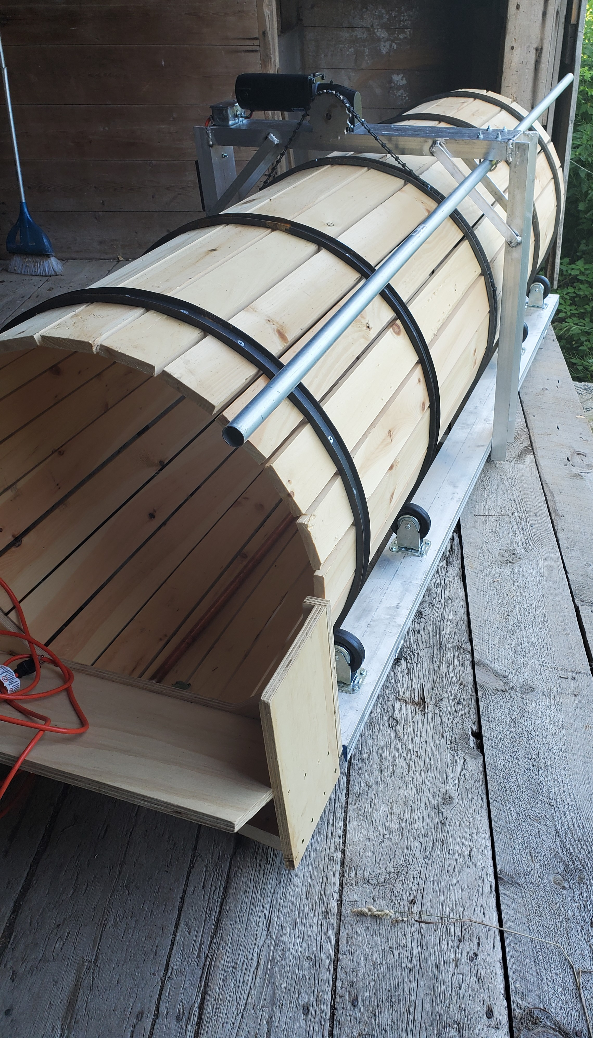
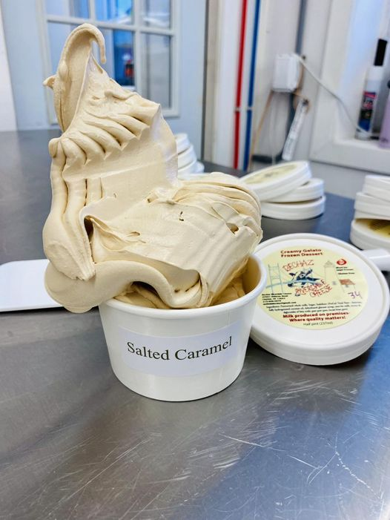
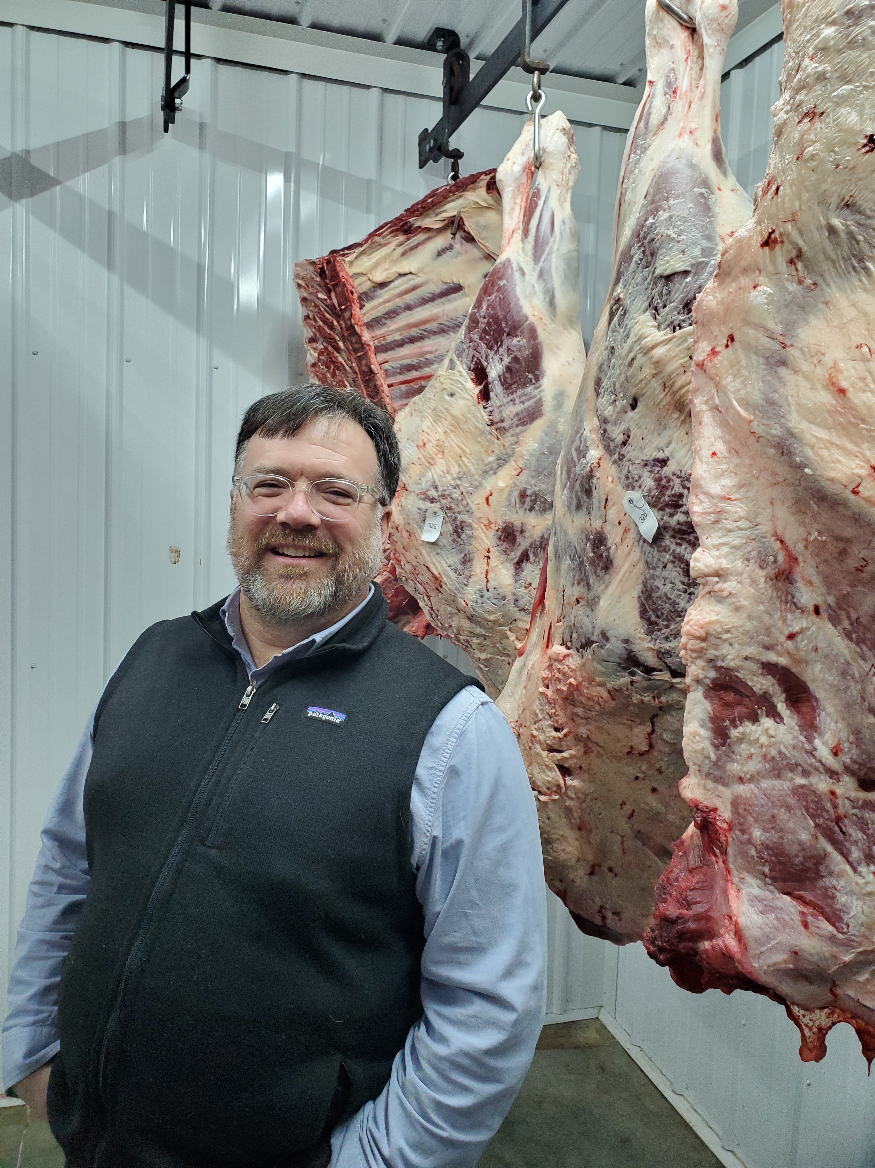

Slide 23
Jefferson County Food Resiliency Program Round 2
JCBOL allocated $500,000 from ARPA funds to grow agricultural production capacity and $100,000 to continue food processing growth.
Cooperative Project between JCED and Cornell Cooperative Extension of JC.
Ag Production Capacity = growing or raising raw food product, awarded funds to 23 projects.
Processing = turning the raw food product into a value - added product. Awarded funds to 19 projects.

Slide 25
Questions?
Jefferson County Economic Development
800 Starbuck Avenue, Watertown NY 13601
315-782-5865
www.jcida.com

